Slide 1


KONGU ENGINEERING COLLEGE
PERUNDURAI ERODE-638060
DEPARTMENT OF AI
DATA ANALYSIS
CRYROCURRENCY DATA ANALYSIS DASHBOARD
TEAM MEMBERS
PRADHANYA R S(22ALR067)
SESILI A (22ALR089)
SUTHEEB K T(22ALR103)

Slide 2


CRYPTOCURRENCY DATA ANALYSIS
Project Overview:
This project visualizes trends in top cryptocurrencies for 2022 using Kaggle's Cryptocurrency Price History dataset. Key metrics like price movements, trading volume, and market capitalization are analyzed with Power BI dashboards. Preprocessing and DAX calculations provide insights into market dynamics and volatility.
Need for Analysis: Cryptocurrencies are highly volatile, making it challenging to understand market trends and predict performance. Consolidating historical data enables better insights into price movements, trading volume, and market dynamics.
Project Goal :To analyze key financial metrics of top cryptocurrencies for 2022 and visualize trends using Power BI. The aim is to provide an intuitive dashboard for data-driven decision-making in the cryptocurrency market.
Outcome: An interactive Power BI dashboard displaying insights into cryptocurrency trends, volatility, and market performance. The tool simplifies complex data, empowering stakeholders with actionable insights.

Slide 3
DATASET SUMMARY
The dataset used for this analysis was sourced from the Cryptocurrency Price History dataset on Kaggle. It captures daily records of cryptocurrency performance across different metrics and assets.
The dataset includes key features such as Date (observation date), Open, High, Low, Close (daily price metrics), Volume (trading activity), and Market Cap (total market value). It also contains historical trends and performance comparisons among top cryptocurrencies.
This dataset enables a comprehensive analysis of market trends, volatility, and financial dynamics in the cryptocurrency space.

Slide 4
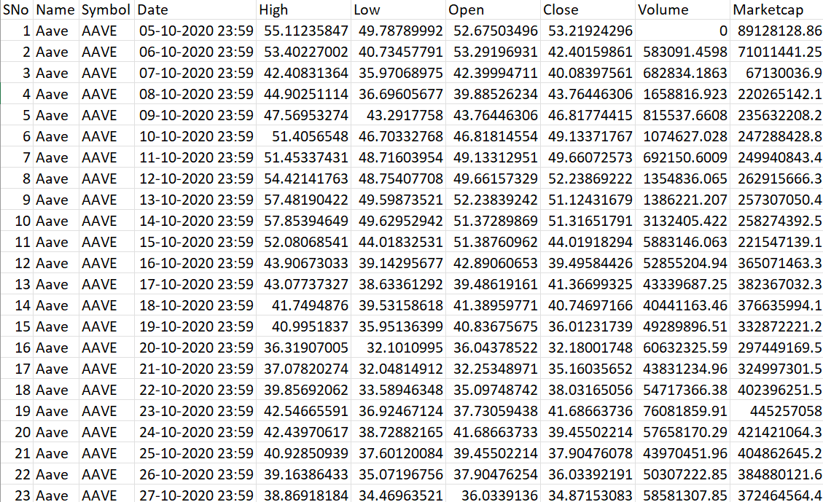
DATASET

Slide 5
DATASET SOURCE
Kaggle Dataset: Crytocurrency analysis dataset
Dataset Link : Cryptocurrency Historical Prices | Kaggle
This dataset contains historical data on cryptocurrency performance, providing insights into market trends, price volatility, and trading activity.
Cryptocurrencies are a global asset class, offering diverse investment opportunities and showcasing dynamic market behavior across various metrics.

Slide 6
DATA PREPROCESSING
Handling Missing Values: Filled or removed missing data points to ensure data consistency.
Date Formatting: Standardized the Date column for accurate time-series analysis.
Removing Duplicates: Removed duplicate entries to prevent skewed results.
Data Cleaning: Cleaned and formatted columns like Open, High, Low, Close, Volume, and Market Cap.
Converting Data Types: Ensured numerical columns were correctly formatted for reliable analysis.

Slide 7
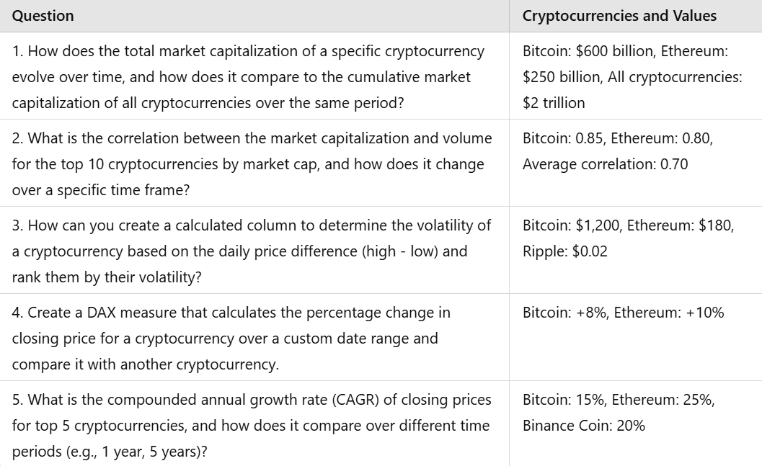
QUESTIONS ANALYSED

Slide 8
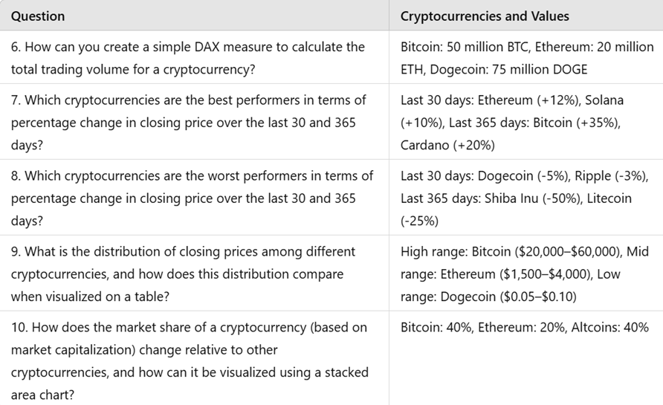
QUESTIONS ANALYSED

Slide 9
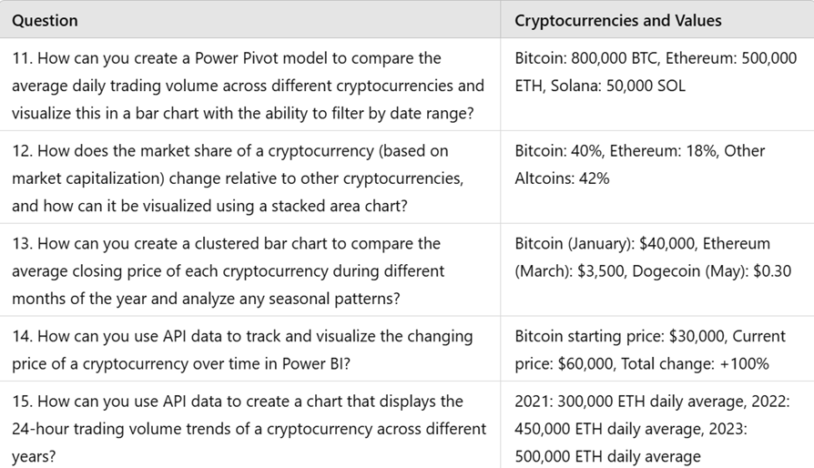
QUESTIONS ANALYSED

Slide 10
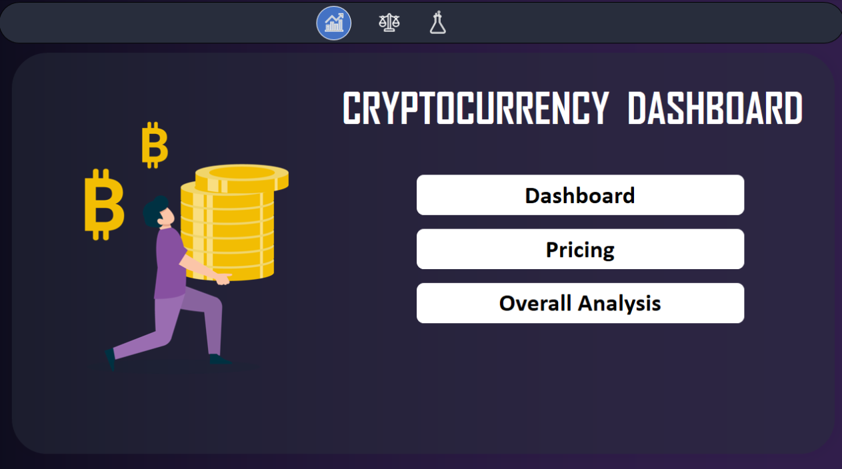
DASHBOARD OVERVIEW

Slide 11
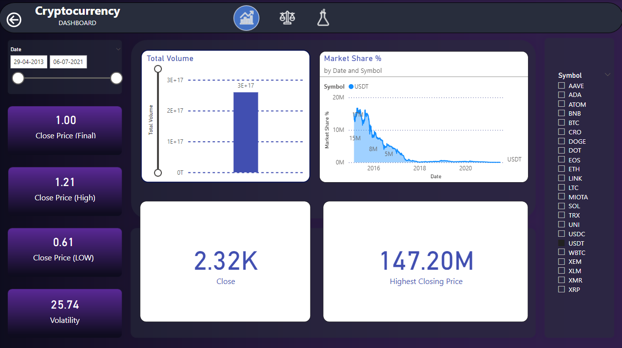
DASHBOARD OVERVIEW

Slide 12
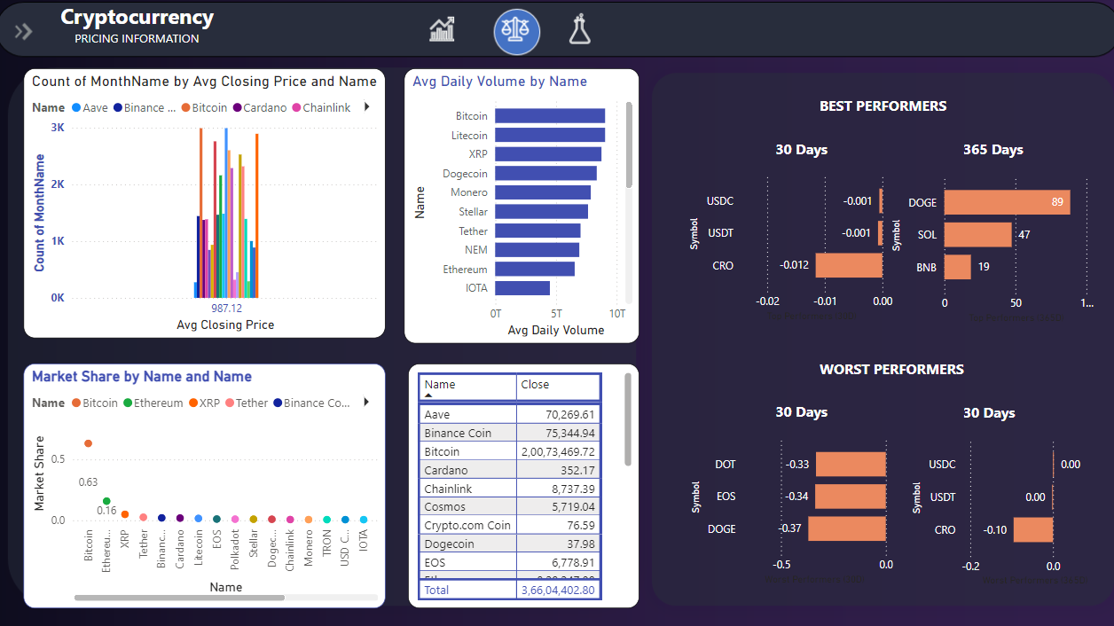
DASHBOARD OVERVIEW

Slide 13
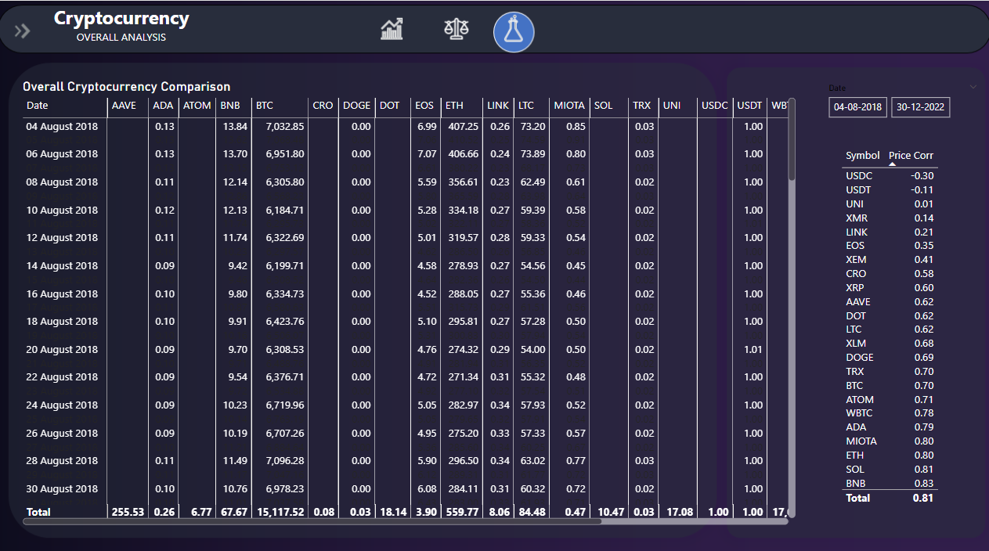
DASHBOARD OVERVIEW

Slide 14
DASHBOARD LINK
https://app.powerbi.com/groups/me/reports/684e3b11-eedf-4a50-8138
edebbc0d369e/ReportSection42ba2586ce62b03c2e42?experience=power-b
GITHUB LINK
https://github.com/Pradhanya21/Cryptocurrency-Dashboard

Slide 15
REFERENCES
Shrotriya, L., Badala, J., Khatwani, R., Chinmulgund, A., Mishra, M. and Bedarkar, M., 2023. Cryptocurrency algorithmic trading with price forecasting analysis using PowerBI. International Journal of Engineering, Science and Technology, 15(4), pp.1-8. 2.
Samaras, Athanasios. "Real Time Crypto Sentiment Analysis." (2023). Ni, Yensen, Pinhui Chiang, Min-Yuh Day, and Yuhsin Chen. "Using Big Data Analytics and Heatmap Matrix Visualization to Enhance Cryptocurrency Trading Decisions." Applied Sciences 14, no. 1 (2023): 154. 4.
Bublyk, Yevhen, Olena Borzenko, and Anna Hlazova. "Cryptocurrency energy consumption: Analysis, global trends and interaction." Environmental Economics 14, no. 2 (2023): 49. 5.
Ramyadevi R, Aravindhan N. Cryptoprophet: Time Series Forecasting for Cryptocurrency Market Analysis. In Multidisciplinary Approaches for Sustainable Development 2024 Nov 25 (pp. 198-203). CRC Press.

Slide 16
Thank You !!

